Slide 1
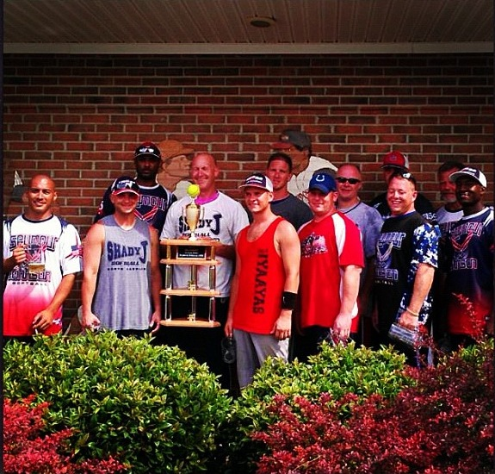
2013 Southeastern AMMO Bowl, Smithfield, NC
2012 Champions – Seymour Johnson

Slide 2
General Information
-- August 3-4
-- $400 entry fee (may change depending on participation)
-- Players pool -- First Come; First served (not an option if you have a “B” Team)
-- HR Derby-12 pitches (10 Cuts) (Saturday Lunch)
$10 per entry (Prize TBD, Bat or 50/50)
-- Prizes to 1st, 2nd, 3rd Place Teams, All tourney, MVP
-- USSSA format (.44 core balls will be provided)
-- Ice breaker – Friday, 2 August @ ??

Slide 3
General Information
-- Coaches Meeting: Aug 2nd
Coaches meeting @ 1700 at ????????? to discuss rules, drawing for round robin, etc.
-- Games: Aug 3-4
Game time will begin at 0900 Saturday morning at the Smithfield Parks and Recreation Sports Complex and Aquatics Center located at:
600 Booker Dairy Rd, Smithfield, NC 27577 (919) 934-2148
-- Round robin will begin on Saturday with the seeding of the teams.
DOUBLE ELIMINATION will begin on Sunday at 0800. Food and beverages are “pay as you go” (Concessions, BBQ, etc.).
Units intending to participate in the Southeastern AMMO Bowl must notify the tournament directors as soon as possible but NLT June 30, 2013. Please provide two POCs, coach and assistant, team roster with all names, DSN number and e-mail addresses. Also, please provide contact information of Squadron Commander and First Sgt.
An entry fee of $400.00 is due by 15 July. Teams should make checks for their entry fees out to AMMO Top IV and mail to 4 EMS, Attn: TSgt Aaron McClellan, 1055 Weapons Lane, Seymour Johnson AFB, NC 27531.

Slide 4
Personal Conduct
-Number one: Respect each other and family members. Enough said. This is too good to be shut down… expect local community members
- The legal age to consume alcohol is 21. Alcohol will be served at the icebreaker, so please drink responsibly!
- Have a plan to and from the fields as well as Saturday night if you intend on going out. Don’t drink and drive! We will have designated drivers to get you back to the hotel.
-Respect the hotel and the Smithfield Parks and Recs complex. They have given us a great deal and the local community expects a great atmosphere to watch us play… please act accordingly.
-Bottom line we want everyone to have a great time! Use common sense and watch out for your fellow AMMO Troop. We expect the Ranking Individual/Team coach to be responsible for personnel from their units.

Slide 5
Icebreaker/ Hotel Information
Hotel Reservations:
Sleep Inn--919-209-2372 $86.00 per night
Super 8--919-989-8988 $83.31/66.58(Sun) per night
-Under the name “James Pyeatt”(30 Rooms are blocked at Sleep Inn, Super 8)
Other hotels in the area: Jameson, Comfort Inn, Holiday Inn Express,
-Beer and food will be provided during icebreaker FREE of charge to players (Guests and family members $5.00 each)
-I recommend that everyone stay at the Sleep Inn for the weekend. It’s the nicest hotel in the area for the price!

Slide 6
Tournament Rules
Format:
USSSA pitching/fielding start with 1-1 count for all games.
Equipment:
Any bats that are ASA/USSSA/ISA/NSA approved.
NO ULTRA II.
Bats in question will be inspected by officials. Tournament committee will
make final ruling.
Balls are provided for all games, only those provided will be allowed!!!
Chase your own HR and/or get old balls from ump.
Game time:
Game time is forfeit time. All pool play games are 55 minutes. All double elimination games will be 60 minutes. Championship game will not have a time limit… you will play 7 innings (No run rule).
Run rule:
20 after 3
15 after 4
10 after 5 for all games except Championship.
Home runs; UNLIMITED!!!!!! You hit ‘em… you get ‘em.

Slide 7
Tournament Rules
Stealing:
Not allowed.
Roster:
Official rosters must be into the tournament director prior to Icebreaker.
Protests:
Must be made before the next pitch of that inning to the home plate
official. Play will continue and be decided on by the tournament
committee.
Ejections:
Removed from field first time and then rest of games for second offense (ruled on by tournament committee) There will be security at the fields!
Tie breaker:
Head to head
Run Differential
Total runs scored
Total runs allowed

Slide 8
Tournament Rules
Tournament Eligibility:
-Eligibility for team members is limited to 2W0X1, 2W1X1, 2W2X1, and
support personnel assigned directly to the UNIT and working behind the
fence. ALL RETIRED AMMO TROOPS are eligible!!!!!
Example:
-3A0X1 working as the Munitions Flight Admin. OK
-3P0X1 Security police who works the gate. NO GOOD
Individuals that are not assigned to a team package will be charged a
$20 entry fee for the tournament

Slide 9
Contact Information
Tournament Directors Email and DSN/Commercial #
POC: SrA Kaitlyn McClenahan @ DSN 722-7210/kaitlyn.mcclenahan@seymourjohnson.af.mil
Alt. MSgt Tony Patrick @ DSN 722-7056 Anthony.patrick@seymourjohnson.af.mil
SSgt Damon Hairston @ DSN 722-7163 Damon.Hairston@seymourjohnson.af.mil
TSgt Randy Wilhide @DSN 722-7163 Randy.Wilhide@seymourjohnson.af.mil
MSgt Christopher Saffel @ DSN 722-7216 or christopher.saffel@seymourjohnson.af.mil
An entry fee of $400.00 is due NLT 15July. Any team wishing to
participate will be assessed a $50 late fee after that date.
Units intending to participate in the Southeastern AMMO Bowl must notify the tournament directors as soon as possible but NLT June 30, 2013. Please provide two POCs, coach and assistant, team roster with all names, DSN number and e-mail addresses. Also, please provide contact information of Squadron Commander and First Sgt.
An entry fee of $400.00 is due by 1 July. Teams should make checks for their entry fees out to AMMO Top IV and mail to 4 EMS, Attn: TSgt Aaroan McClellan , 1055 Weapons Lane, Seymour Johnson AFB, NC 27531.

Slide 10

City/Park Info
Smithfield is located right off of I-95
Shopping, Outlets, and many restaurants
SRAC has a pool & splash park for the kids www.sraconline.com
Park address:
600 Booker Dairy Rd, Smithfield, NC
The park is a very nice 4-plex (we will be playing on fields 1-3)
BP can be taken on the baseball field (Field 4) or two other soccer fields
Do what we do: Hang out w/ old friends, play some ball, and have fun!!!
Water Park Fees: $8.00 Military
Kids 3 & Under: Free!!!

Slide 11

Lions Water Adventure
There is also another water park in Kinston which is about 40 min from ballpark
2602 W. Vernon Ave, Kinston, NC
$10 per person open 11:30-5:30
https://www.facebook.com/LionsWaterAdventure#!/LionsWaterAdventure

Slide 12
PLAN FOR NEXT YEAR
As all of you know Smithfield is not our first choice to host Ammo Bowl. Those of you that will stick with us have to option to play at Myrtle Beach in 2014. It takes 2 years to get field down there and we have finally made it on the list. So the dates are locked in to host AMMO Bowl at Myrtle Beach for 2014. It will be there for which ever team wins this year to defer it to Myrtle Beach if needed.

